Slide 1
Motion Exercise 2
Positioning

Slide 2
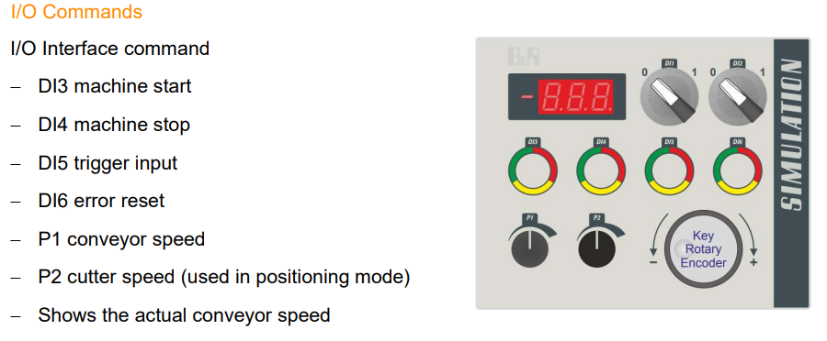
Device used: 4 SIM. 10-01 and Inputs and Outputs

Slide 3
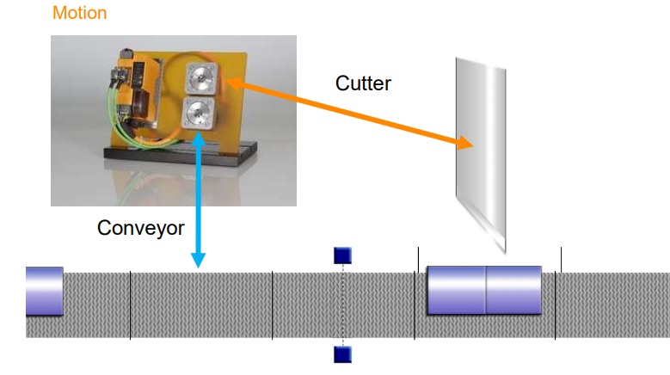
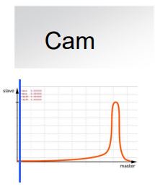
MACHINE_CONTROL
CUTTER_CONTOL
CONVEYOR_CONTORL

Slide 4
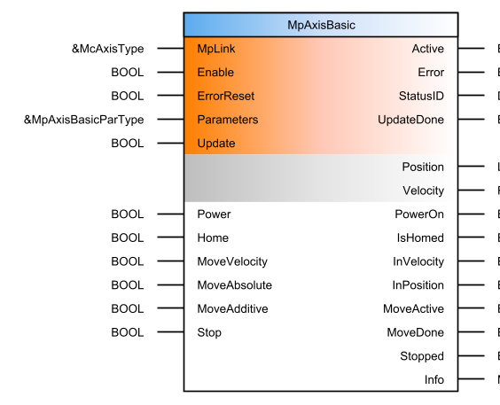
Function Block : MpAxisBasic used
This function block covers all basic functions of an axis.
The function block offers administrative commands such as switching on and homing as well as base movements, torque limitation or control of the holding brake. In addition, the function block provides information about the axis status as direct outputs and in info structure outputs.

Slide 5
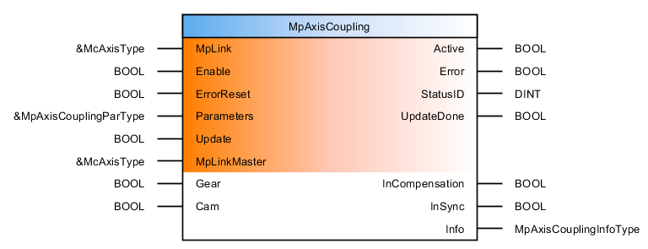
Function Block: MpAxisCoupling used
This function block enables simple couplings between two axes.
This function block is used for simple axis couplings. It allows for linear and nonlinear couplings as well as shifts that can be up-modulated using the master or slave position. The master and slave are specified using inputs "MpLinkMaster" and "MpLink".
All settings for the couplings must be made in structure MpAxisCouplingParType.

Slide 6
Machine States
MACHINE_OFF_STATE (Initial state: waiting for the start signal)
INITIALIZE_STATE (Initialization state: initializing the conveying and cutting equipment)
CONFIRM_CONVY_MV (Start state: starting the conveying equipment)
CONVY_MV (Running state: the equipment is running normally, waiting for the camera trigger signal)
SENSOR_STATE (Trigger state: the camera is triggered)
CAM_STATE (Camera state: the camera has completed the work and returned to the RUNNING state)
FAULT_STATE (Fault either in Conveyor axis or Cutter axis )

Slide 7
Conveyor State
CONVY_OFF_STATE (Initial state: waiting for axis to be ready and initialized)
POWER (Initialization state: enabling axis and returning to zero)
CONFIRM_POWERED (Ready state: axis return to zero is complete, ready for the next operation)
CONFIRM_INITIALIZE (Axis enable state: waiting for movement instructions)
SET_CONVY_VEL (Conveyor start state: set up and start movement)
CONV_MOVING (Conveyor moving state: constantly update speed parameters, and record trigger position)
FAULT_STATE_CONVEYOR (Fault either in Conveyor axis or Cutter axis)

Slide 8
Cutter State
CUTTER_OFF_STATE (Initial state: waiting for the axis to be ready and initialized)
POWER (Initialization state: enabling the axis and returning to zero)
INITIALIZE_AXIS (Ready state: axis return to zero is complete, ready for the next operation)
CAM_STATE (Axis enable state: waiting for the camera trigger signal)
CAM_STATE (Synchronization initialization state: set synchronization parameters and start synchronization)
CONFIRM_CAM (Synchronization in progress state: synchronization is completed, return to the axis enable state)
FAULT_STATE_CUTTER (Fault either in Conveyor axis or Cutter axis)

Slide 9
Machine Workflow
INITIALIZE_STATE
Not conv_init
Not cut_init
MACHINE_OFF_STATE
CONFIRM_CONVY_MV
StartButton
move_conv
CONVY_MV
SENSOR_STATE
CAM_STATE
CONVY_MV
White_Button_Button
activate_cam
cam_done
Keep moving

Slide 10
Conveyor Workflow
ReadyToPowerOn
PowerOn
CONVY_OFF_STATE
POWER
CONFIRM_POWERED
IsHome
CONFIRM_INITIALIZE
mov_conv
SET_CONVY_VEL
mp_axis.InVelocity
mp_axis.InVelocity= conveyer_velocity
CONV_MOVING
CONV_MOVING
SET_CONVY_VEL
mp_axis.UpdateDone
Record the position of AXIS
Keep moving

Slide 11
Cutter Workflow
mp_axiscutt.IsHomed
CUTTER_OFF_STATE
ReadyToPowerOn
PowerOn
HOME
INITIALIZE_AXIS
POWER
activate_cam
NOT mp_coupling.CommandBusy
CAM_STATE
mp_coupling.InSync
CONFIRM_CAM
Repeat

Slide 12
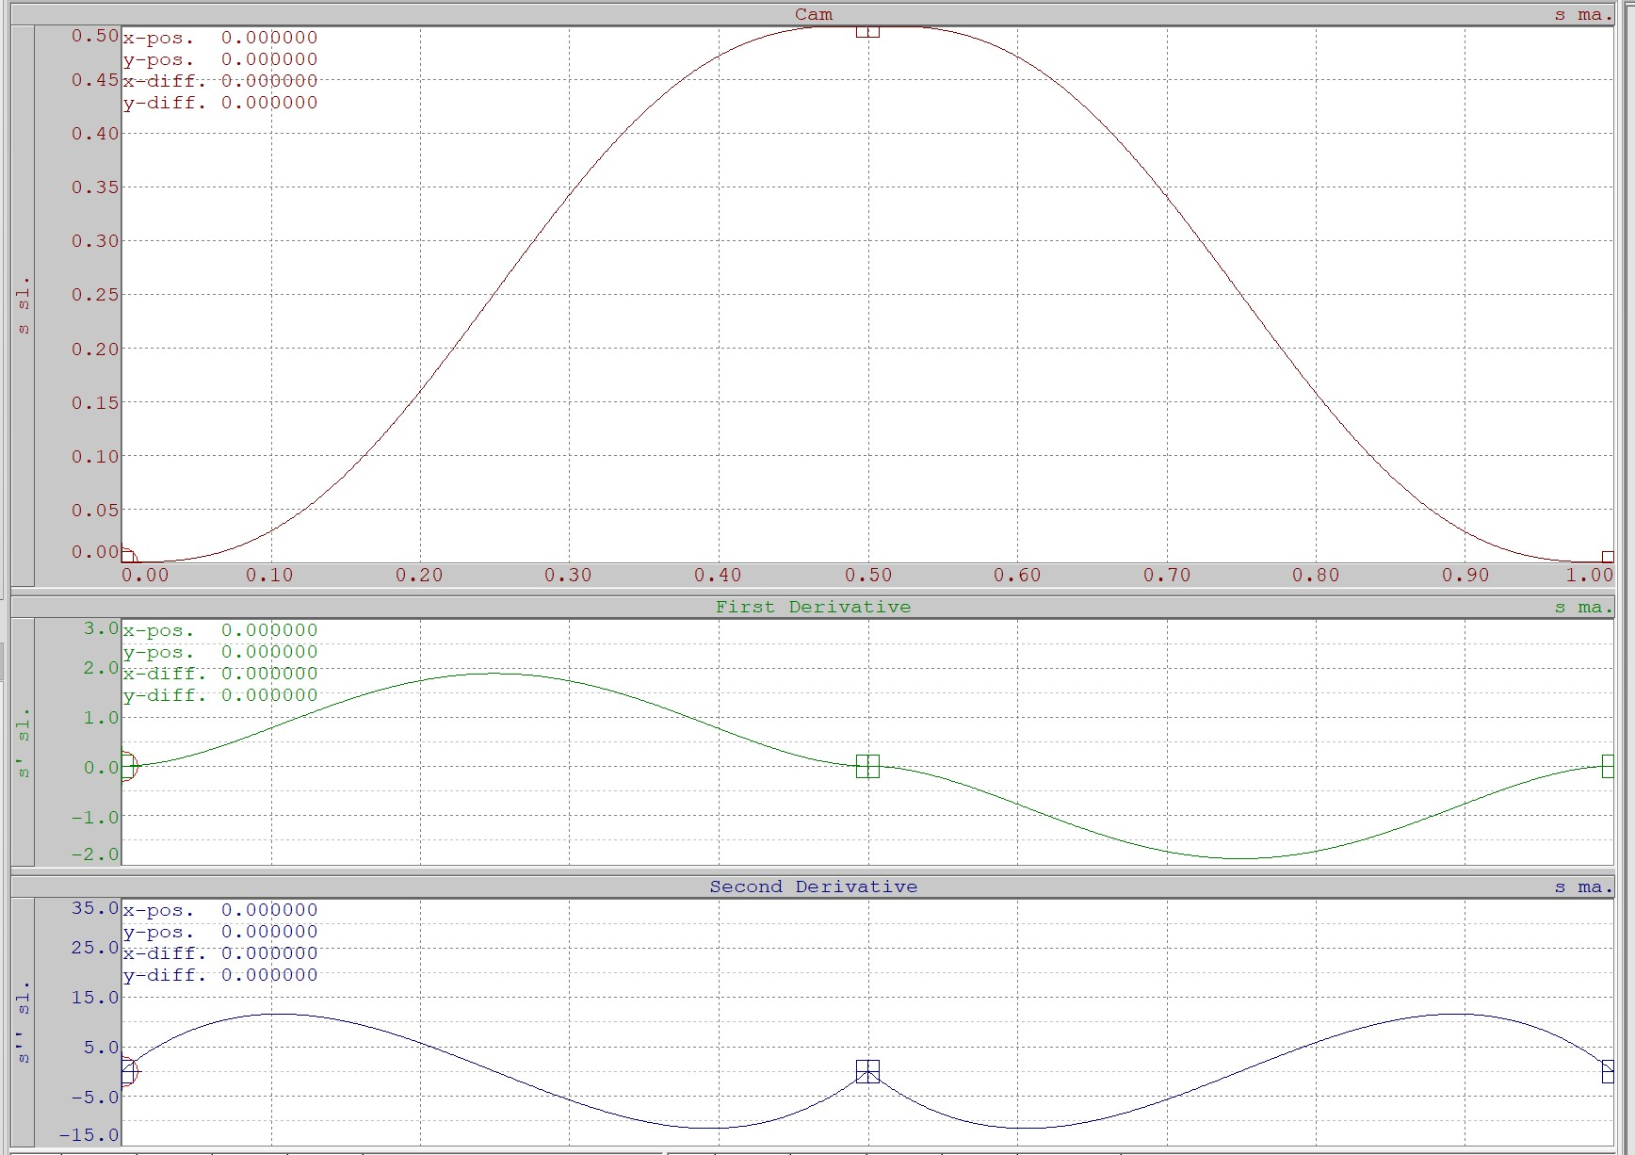
CAM PROFILE

Slide 13

Error Management
CONVEYOR_CONTORL:
IF(FAULT) THEN
axis_command := ‘STOP’;
conveyor_state := FUALT_STATE_CONVEYOR;
END_IF;
MACHINE_CONTROL:
IF(ConveyorError OR CutterError) THEN
FAULT := TRUE;
stop_machine := TRUE;
MACHINE_STATE:= FUALT_STATE;
END_IF;
CUTTER_CONTOL:
IF(FAULT) THEN
axis_command := ‘STOP’;
cutter_state := FUALT_STATE_CUTTER;
END_IF;

